Slide 1
Blockchains and IoT: a reality check
Pekka Nikander, Aalto University
IoT Week 2018, Bilbao

Slide 2

Outline
Introduction
Constraint device characteristics
Distributed Ledgers reality
Toughest stuff in practice
Conclusions

Slide 3
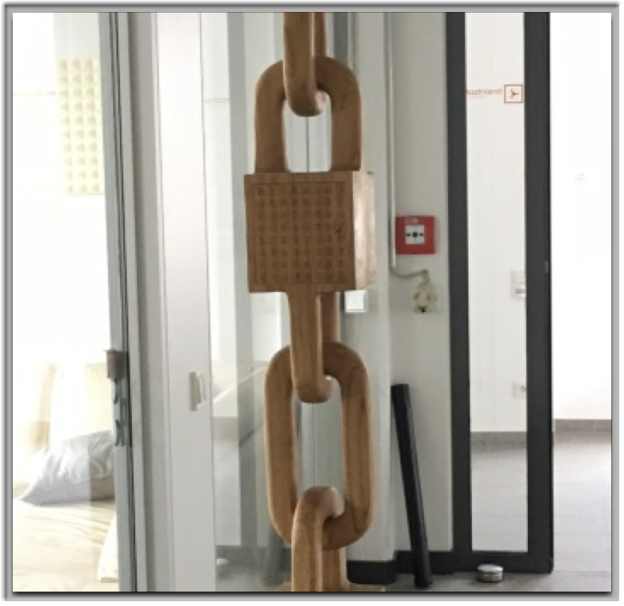
Introduction
Blockchains are touted as the panacea for IoT security
But blockchains are bulky
Do they really fit with IoT?

Slide 4
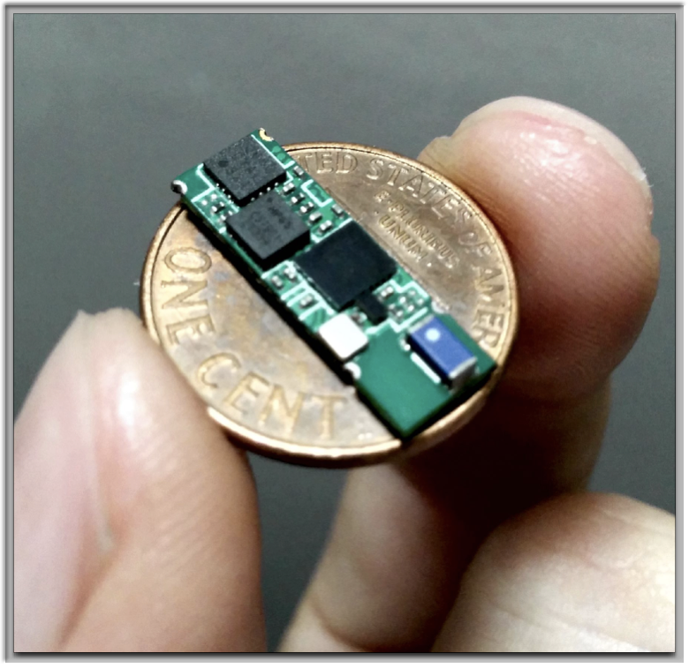
Constrained devices
Tiny things
4 kb SRAM, 32 kb Flash
But often a 32 bit CPU
Small devices
256 kb to 2 Mb of RAM
Few megabytes of Flash

Slide 5
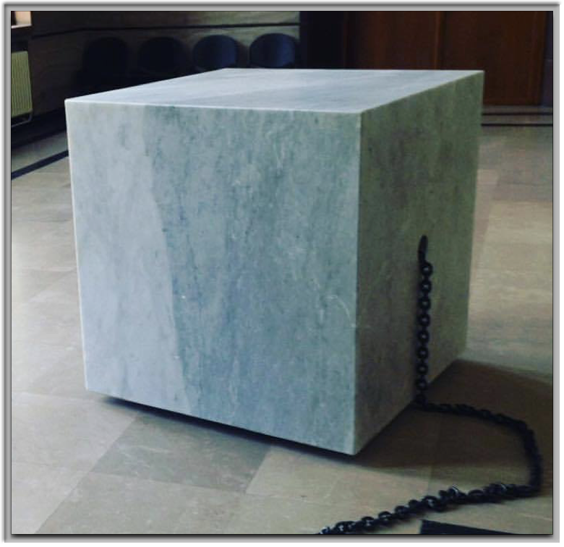
Distributed ledgers reality
A full node is bulky
even for IOTA…
Full node needed to trust
Trust involves checking

Slide 6
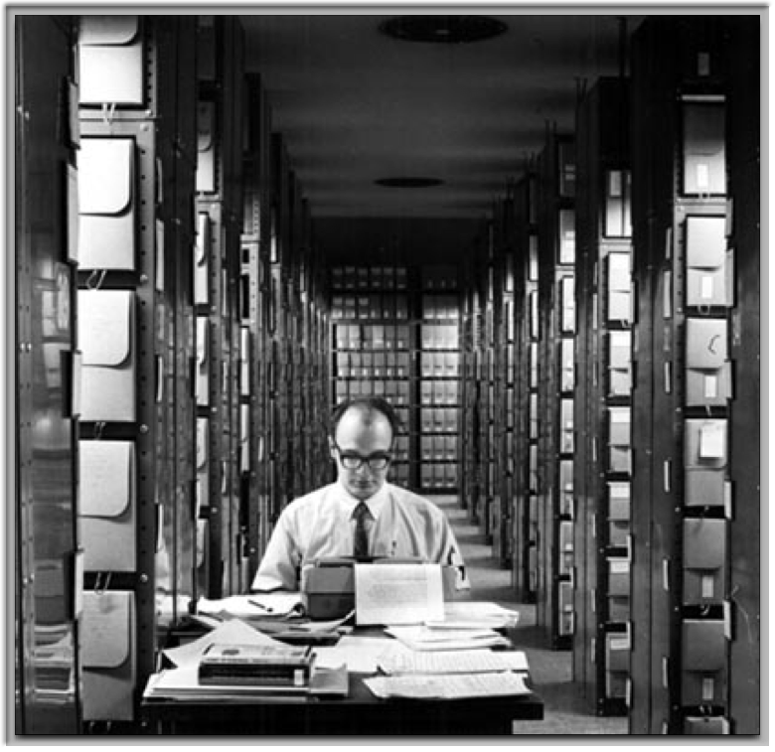
Ethereum system requirements
Ethereum archival node: stores all of Ethereum history
1.1 Tb of striped SSD ( 2 x 1 Tb fast SSD )
Server class fast PC
Finland’s fastest available Internet connectivity
Sync from zero: 2 weeks

Slide 7

Ethereum system requirements
Ethereum full node: able to verify new transactions (and mine, with a GPU)
10 Gb of storage
Minimum 4 Gb memory
Sync from zero: about 2 hours

Slide 8

Ethereum reality
Time to secure a transaction:
about 2 minutes
Cost to secure a transaction:
average today ~ $1*
very volatile: $ 0.40 – 4.15
* For an average sized transaction. Mere fund transfer some $ 0.20 as of today.

Slide 9

IOTA reality
IOTA full node
20+ GB of Storage
4+ GB of RAM
Server class PC

Slide 10
Reality check
 | Tiny thing | RasPi 3+ | IOTA full node | Ethereum full node | Ethereum archive
CPU MIPS | 40 | 2500 | 50 000 ? | 100 000 | 100 000
RAM | 4 kb | 1 Gb | 4 Gb | 8 Gb | 16 Gb
Storage | 32 kb | 32 Gb | 20 Gb | 20 Gb | 1100 Gb
Read speed | 600 Mbps | 2 Gbps | > 100 Mbps ? | ~ 1 Gbps | ~ 1 Gbps
Write speed | < 100 kbps | ~ 1 Mbps | > 100 Mbps ? | ~1 Gbps | ~ 1 Gbps
Node cost | < $5 | < $40 | > $200 ? | > $500 | > $2000
Some numbers are educated guesses. IOTA numbers largely unknown.

Slide 11
Reality check ( in relative terms, Ethereum = 1 )
What we have
What we need
Note: No mining involved here, merely keeping up to date

Slide 12
Toughest aspects
Cost: Cannot afford a full DLT node ( > $200 ) everywhere
Even if can afford storage space, not the storage I/O speed
Latency: Often < 2 seconds vs. minutes or hours in DLT
Intermittent connectivity: IoT must work even if Internet is down
Sometimes possible to tolerate reduced functionality for a while

Slide 13
Verdict
DLTs don’t help individual IoT systems: you need trusted nodes anyway
DLTs may be useful for inter-connecting IoT systems
Cf. e.g. the EU H2020 project SOFIE, http://sofie-iot.eu
DLTs are not a panacea for IoT security problems
Among other things, public DLTs are very expensive to use
E.g. cost of computing in Ethereum ≈ 1 000 000 × computing in cloud

